Slide 1
MIMIC-IV Cohort Construction
BMI 6016 – Data Wrangling Semester Project
Abby Chen, Brian Adams, Joe Dawson, Yannick Jones
What MIMIC-IV is and why researchers use it
How to load it in PostgreSQL and query it in BigQuery
How the SQL script builds a vascular surgery master cohort
EDA and Results

Slide 2
Postoperative Acute Kidney Injury (PO-AKI)
Sentinel Surgical Complication (i.e., can be avoided by following proper procedures and techniques)
Associated with adverse outcomes: longer hospital length of stay, ICU admission, prolonged mechanical ventilation, tracheostomy, discharge to nursing facility, and higher 30-day readmission rates
PO-AKI is often low-grade (stage 1-2 AKI) but is identified by a lagging biomarker after significant kidney injury may have already occurred
Occurrence:
Cardiac Surgery: 20%
Vascular Surgery: 20-70%
Acronyms: PO = Postoperative, AKI = Acute Kidney Injury, ICU = Intensive Care Unit
Source: Naomi et al. 2022. DOI: 10.2215/CJN.16541221

Slide 3
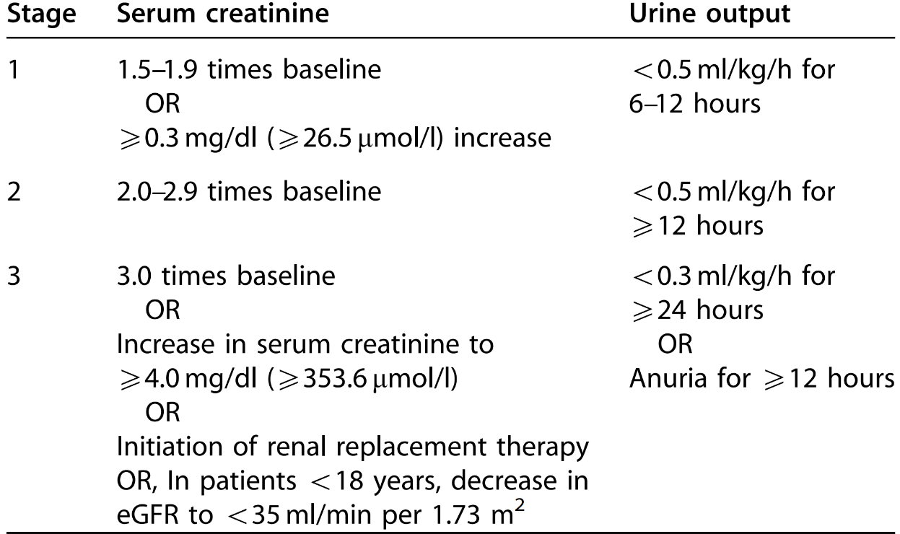
KDIGO Definition and Classification of AKI
Acronyms: KDIGO = Kidney Disease: Improving Global Outcomes
Source: KDIGO Clinical Practice Guideline for Acute Kidney Injury. Official Journal of the International Society of Nephrology. 2012. 2(1)

Slide 4
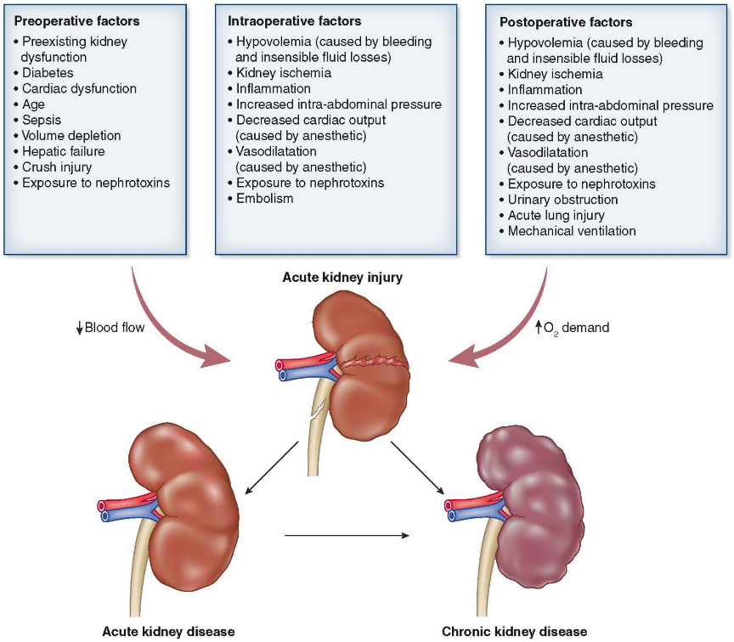
Causes of Postoperative AKI
Kidneys are among the most metabolically active organs in the body:
Kidney: 426 kcal/kg/day
Heart: 426 kcal/kg/day
Brain: 233 kcal/kg/day
Liver: 194 kcal/kg/day
Sk. Muscle: 12.6 kcal/kg/day
Adipose: 4.4 kcal/kg/day
Acronyms: AKI = Acute Kidney Injury
Sources: 1) Naomi et al. 2022. DOI: 10.2215/CJN.16541221 2) Wang et al. 2010. doi: 10.3945/ajcn.2010.29885

Slide 5
Literature Search: Association of PO-AKI and Hypotension
Search Engine: Google Scholar
Search Term: “mean arterial pressure postoperative acute kidney injury”
24 observation, retrospective and intervention studies selected
2 meta-analyses
Findings:
Perioperative hypotension is associated with PO-AKI (MAP <65 mmHg for over 5 min). Some studies suggest maintaining perioperative MAP of 70 – 95 mmHg for hypertensive patients.
Postoperative hypotension is often associated with increased incidence of PO-AKI. Some studies suggest maintaining a postoperative MAP of >75 – 90 mmHg.
Acronyms: PO = Postoperative, AKI = Acute Kidney Injury, MAP = Mean Arterial Pressure

Slide 6
1. MIMIC-IV in one slide
A public critical care database for reproducible clinical analytics
This slide is designed for a quick, classroom-friendly explanation of the dataset.
What it is
Why it matters
How to access
De-identified EHR data from Beth Israel Deaconess Medical Center. Includes admissions, ICU stays, labs, medications, procedures, notes, and outcomes.
Supports epidemiology, risk modeling, ICU outcomes research, and training in data wrangling and feature engineering.
Credentialed access through PhysioNet with local loading into PostgreSQL, or cloud querying through BigQuery.
Acronyms: MIMIC = Medical Information Mart for Intensive Care, EHR = Electron Health Record, ICU = Intensive Care Unit

Slide 7
2. Getting MIMIC-IV into a working environment
Two common workflows: local PostgreSQL or hosted BigQuery
The choice mostly changes where the SQL runs, not the underlying logic.
PostgreSQL
BigQuery
Tradeoff
Complete PhysioNet credentialing, download the CSV/gzip files, create the database and schema, then load tables with the provided DDL/COPY workflow.
Query the hosted cloud version directly with SQL in the browser or a client. Useful for rapid prototyping and large joins.
PostgreSQL gives local control and easy indexing; BigQuery reduces setup time and scales well for exploration.

Slide 8
A. Original vascular surgery cohort select
Sources
Logic
Output
The script begins with the vascular surgery admissions that define the study backbone.
The cohort is anchored at the patient-admission level, with subject_id and hadm_id retained for every downstream join.
This table is the starting population for all later feature and outcome summaries.
The SQL filters MIMIC-IV records to admissions that meet your vascular surgery inclusion logic.
Those records are then standardized into one backbone table so later queries can reuse the same admissions.
The cohort is intentionally wide at this stage: it captures the study population before any analytic features are added.
A cohort backbone table, stored as mimiciv_icu_vascular_aki.Patients.
One row per admission, ready for table-by-table enrichment.
All later summary tables join back to this backbone using hadm_id.

Slide 9
2A. complex_aortic_summary
Sources
Logic
Output
mimiciv_hosp.diagnoses_icd supplies ICD-9 / ICD-10 diagnosis codes.
mimiciv_note.discharge supplies free-text discharge summaries.
mimiciv_icu_vascular_aki.Patients supplies the cohort backbone and hadm_id anchor.
The code searches diagnoses for complex aortic ICD patterns and collapses them to one row per admission.
It also scans discharge notes for keywords such as suprarenal clamp, supraceliac, juxtarenal, thoracoabdominal, and pararenal.
The ICD-based and note-based signals are aggregated, then joined back to the cohort.
subject_id and hadm_id are carried forward for alignment.
complex_aortic = 1 if either the ICD search or note search is positive.
This is a phenotype-style binary flag rather than a raw event count.

Slide 10
2B. aki_time_windows_summary
Sources
Logic
Output
mimiciv_icu.icustays provides the ICU start time used as the anchor.
mimiciv_hosp.labevents provides creatinine measurements (itemid 50912).
The core Patients cohort supplies the admissions being evaluated.
Baseline creatinine is taken from the pre-ICU / admission window, using values from 7 days before ICU start through 24 hours after.
Daily maximum creatinine is then calculated from 24 hours before ICU start through 7 days after.
Each window is checked against AKI thresholds to determine whether criteria are met and which stage is reached.
aki_24h_flag, aki_72h_flag, and aki_7day_flag indicate whether AKI occurred in each window.
max_aki_stage_7day stores the worst AKI stage over 7 days.
This table converts repeated creatinine measurements into a compact outcome summary.

Slide 11
2C. map_twa_summary
Sources
Logic
Output
mimiciv_icu.chartevents provides bedside vital-sign measurements.
mimiciv_icu.icustays defines the ICU anchor time.
The analysis keeps only physiologically plausible MAP and heart-rate values.
MAP comes from itemids 220052, 220181, and 225312; HR comes from itemid 220045.
The script computes time gaps between consecutive measurements with LEAD(charttime).
Those gaps are used as weights for a 24-hour time-weighted average.
map_twa_24h is the 24-hour time-weighted average MAP.
hours_map_below_65 counts time spent with MAP < 65 mmHg.
hours_hr_above_90 counts time spent with HR > 90 bpm.

Slide 12
2D. hemo_pressor_summary
Sources
Logic
Output
mimiciv_icu.chartevents provides heart-rate measurements.
mimiciv_icu.inputevents provides vasopressor administration records.
The Patients cohort and ICU start time define the 24-hour window.
The first heart-rate value in the first 24 hours is taken as the admission heart rate.
The script sums infusion duration for selected pressor itemids and captures a dose proxy.
Any pressor exposure inside the window sets the vasopressor flag.
hr_admit captures the first ICU heart rate in the window.
vasopressor_flag shows whether pressors were used.
pressor_hours and max_pressor_dose summarize exposure intensity.

Slide 13
2E. renal_fluid_summary
Sources
Logic
Output
mimiciv_icu.outputevents provides urine output.
mimiciv_icu.inputevents provides administered fluids.
mimiciv_icu.icustays supplies the ICU start time for the first 24 hours.
Urine output is summed over the first 24 hours after ICU admission.
Fluid intake is summed over the same period using positive input amounts only.
Fluid balance is calculated as intake minus urine output.
urine_output_24h, total_fluid_intake_24h, and fluid_balance_24h summarize the first ICU day.
The table turns bedside fluid events into one admission-level summary row.

Slide 14
2F. lab_vital_dragnet
Sources
Logic
Output
mimiciv_hosp.labevents supplies laboratory results.
The ICU start time is again used as the anchor point.
The cohort table supplies the admissions being evaluated.
The script looks from 6 hours before ICU start to 24 hours after ICU start.
It groups by hadm_id and summarizes each lab with either an average or a maximum.
Only a small set of high-value labs is retained to keep the final table compact.
bun_mean, wbc_mean, platelets_mean, and lactate_max are created.
This table adds a focused early-lab snapshot to each admission.

Slide 15
2G. safety_survival_summary
Sources
Logic
Output
mimiciv_hosp.labevents provides troponin and hemoglobin.
mimiciv_icu.inputevents provides transfusion-related events.
mimiciv_hosp.admissions and mimiciv_hosp.patients provide mortality and date-of-death information.
Troponin is checked over 72 hours and 7 days after ICU start to detect myocardial injury.
Hemoglobin minimum is taken within the first 24 hours.
Transfusion events are flagged in the first 24 hours, and mortality timing is derived from admission/death timestamps.
myocardial_injury_72h and myocardial_injury_7day capture injury windows.
min_hgb_24h and transfusion_24h capture early blood-related risk.
hospital_expire_flag, date_of_death, and time_to_death_days summarize survival.

Slide 16
2H. comorbidity_summary
Sources
Logic
Output
mimiciv_hosp.diagnoses_icd provides ICD-9 and ICD-10 diagnosis codes.
mimiciv_derived.charlson provides the precomputed Charlson comorbidity index.
The core cohort table supplies the hadm_id values to join on.
Diagnosis codes are translated into binary comorbidity indicators using pattern matching.
The flags cover heart failure, peripheral vascular disease, complicated hypertension, COPD, diabetes, renal disease, liver disease, obesity, and coagulation disorders.
These flags are then joined with the Charlson score to provide a compact baseline severity summary.
charlson_score plus binary comorbidity flags are created.
The table gives each admission a baseline severity profile.

Slide 17
2I. cardiac_meds_summary
Sources
Logic
Output
mimiciv_hosp.prescriptions provides medication names.
The cohort table provides the admissions to scan.
Medication strings are matched with ILIKE so generic and brand variants are both captured.
The script scans prescription text for representative drugs in each cardiovascular class.
Each class becomes a binary flag at the admission level.
Insulin is included as an additional diabetes-management marker.
beta_blocker, ace_arb, statin, antiplatelet, and insulin_flag are created.
This table summarizes medication exposure relevant to vascular and renal risk.

Slide 18
2K. rrt_summary
Sources
Logic
Output
mimiciv_icu.procedureevents provides procedure records.
mimiciv_icu.icustays provides the ICU start anchor.
The cohort table provides admissions to evaluate.
The script looks for procedure itemids associated with dialysis / renal replacement therapy.
Only procedures that occur after ICU start are counted.
The admission is flagged if any qualifying procedure appears.
rrt_flag is created as a binary indicator.
This table marks renal replacement therapy exposure during the ICU stay.

Slide 19
3. master_vascular_cardiorenal_raw
Sources
Logic
Output
The table is built by left-joining every summary table back to the cohort backbone.
The base table is mimiciv_icu_vascular_aki.Patients.
Every summary table is joined on hadm_id so the cohort stays aligned at the admission level.
Left joins keep the cohort rows even when some summary data are missing.
The script combines demographics, hemodynamics, labs, medications, comorbidities, AKI, myocardial injury, RRT, and mortality.
The result is one final row per admission.
An analysis-ready master cohort table.
Each row is a patient admission with engineered features and outcomes.
This is the table you would use for statistical analysis or modeling.

Slide 20
Takeaway
The SQL script turns raw MIMIC-IV events into a single admission-level cohort.
1. Select the vascular surgery cohort.
2. Build focused summary tables around ICU admission time.
3. Convert repeated measurements into binary flags and compact summaries.
4. Left join everything into one master cardiorenal cohort.
The key design choice is the admission-level join on hadm_id.

Slide 21
Postoperative Hemodynamic Risk Profiling
AKI & Myocardial Injury in Vascular Surgery Patients from MIMIC-IV
Data Wrangling Semester Project — Final Results
883
115
37.4%
Patients
Variables
7-Day AKI Rate
1/9

Slide 22
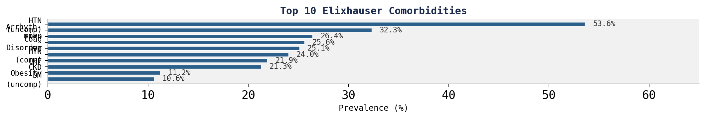
Cohort Demographics & Overview
883 vascular surgery patients from MIMIC-IV admitted to ICU
Patient Demographics
Surgical Procedures
Comorbidity Burden
Age: 66.6 ± 13.4 years (range: 19–91)
Endovascular (ENDO): 459 (52.0%)
Charlson Score: 5.7 ± 2.5 (median 6)
Male: 530 (60.0%) | Female: 353 (40.0%)
Open Surgical (OPEN): 424 (48.0%)
Elixhauser Score: 10.0 ± 8.7 (median 9)
White: 619 (70.1%)
Black/African American: 57 (6.5%)
Complex Aortic: 76 (8.6%)
Hypertension: 53.6% uncomplicated
Hispanic/Latino: 19 (2.2%)
• Suprarenal Clamp: 67 (7.6%)
Arrhythmias: 32.3%
Other / Unknown: 188 (21.3%)
• Complex Endo: 9 (1.0%)
CKD History: 21.3%
2/9

Slide 23
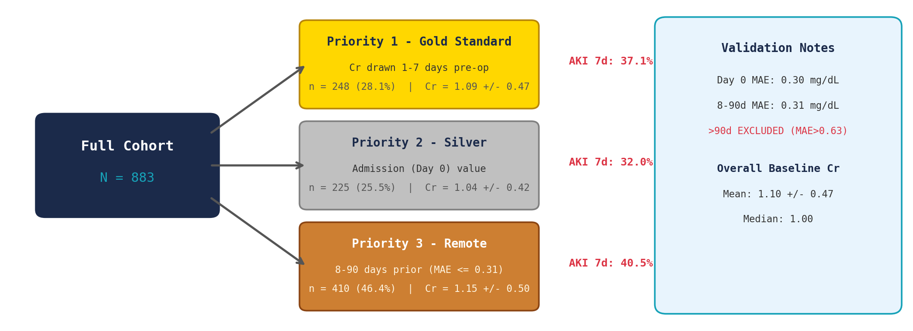
Baseline Creatinine Stratification
Hierarchical strategy to address missing pre-operative creatinine
3/9

Slide 24
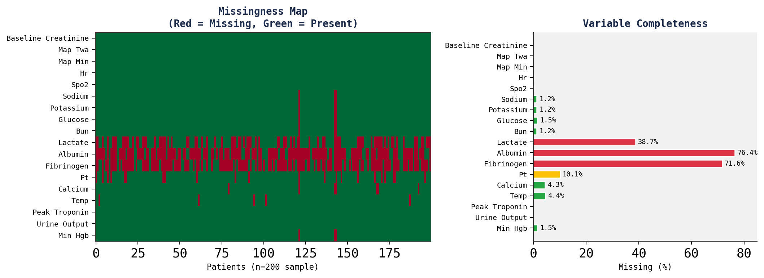
Data Quality Assessment
Completeness, plausibility, and contextual validation per HIDQF framework
Key Findings
Core hemodynamic variables
(MAP, HR, SpO2) are >99% complete
Baseline creatinine: 100%
complete (by design)
Highly missing (>50%):
Albumin (76.4%)
Fibrinogen (71.6%)
AST/ALT/Bilirubin (~60%)
Moderately missing:
Lactate (38.7%)
PT/INR (10.1%)
Biological artifact filter:
MAP <20 or >300 removed
4/9

Slide 25
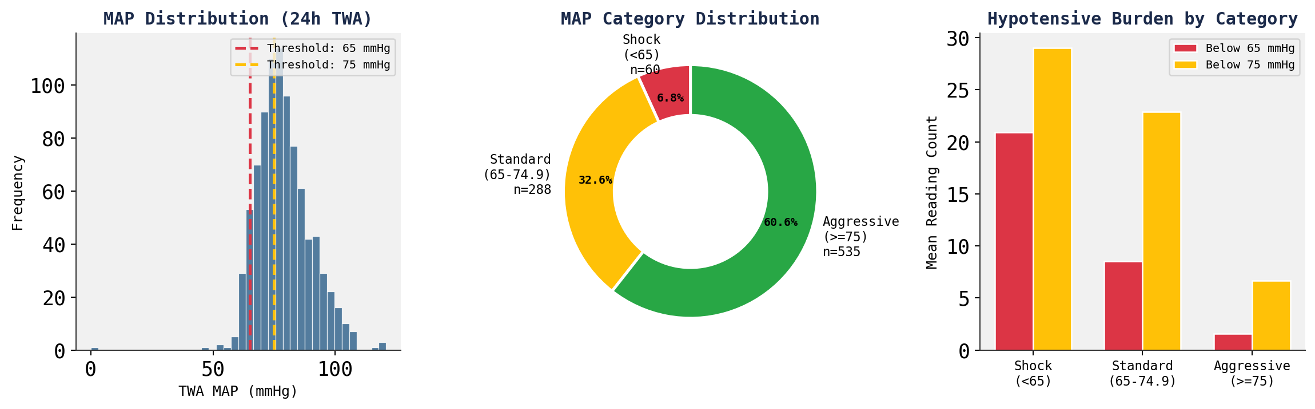
Hemodynamic Exposure: Mean Arterial Pressure
Time-weighted average MAP over first 24 hours of ICU stay
MAP Summary Statistics
Key Insight
TWA MAP: 78.8 +/- 10.9 mmHg | Min MAP: 60.5 +/- 11.1 mmHg
60.6% of patients maintained MAP >= 75 mmHg. Only 6.8% had sustained shock (TWA MAP < 65). The standard (65-74.9) group represents a potential at-risk population (32.6%).
Vasopressor use: 281 (31.8%) | Mean pressor duration: 14.6 hours
5/9

Slide 26
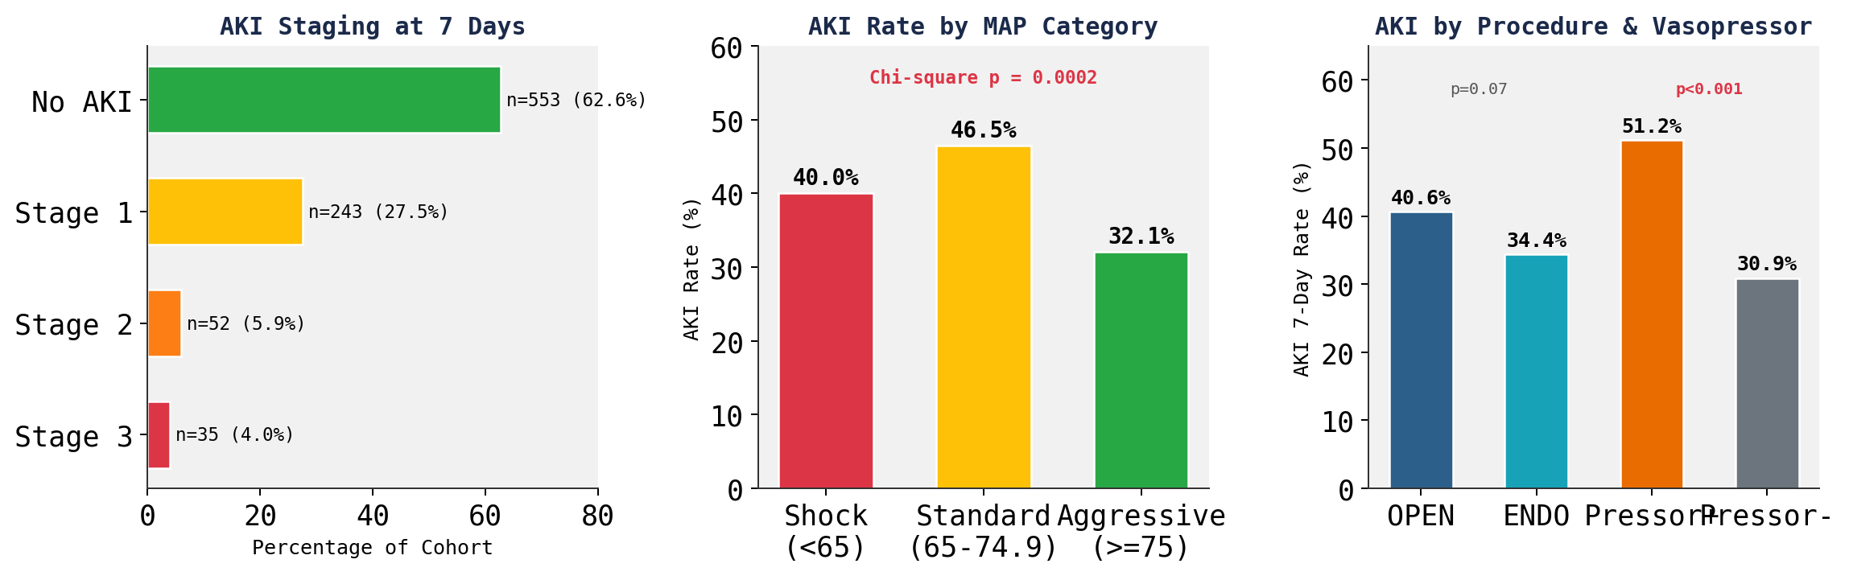
Primary Outcome: Acute Kidney Injury (KDIGO)
AKI within 7 days of surgery using dynamic observation windows
MAP-AKI Association
Comorbidity Risk
Clinical Impact
AKI+ patients had significantly lower TWA MAP (76.7 vs 80.1, p<0.001). Higher baseline Cr strongly associated: 1.26 vs 1.01 (p<0.001).
CKD: 55.3% vs 32.5% (p<0.001) CHF: 50.3% vs 33.8% (p<0.001) HTN (comp): 52.4% vs 32.6% (p<0.001)
AKI+ mortality: 13.6% vs 4.7% (p<0.001) AKI+ ICU LOS: 6.5 vs 3.7 days (p<0.001) 37.4% overall 7-day AKI incidence
6/9

Slide 27
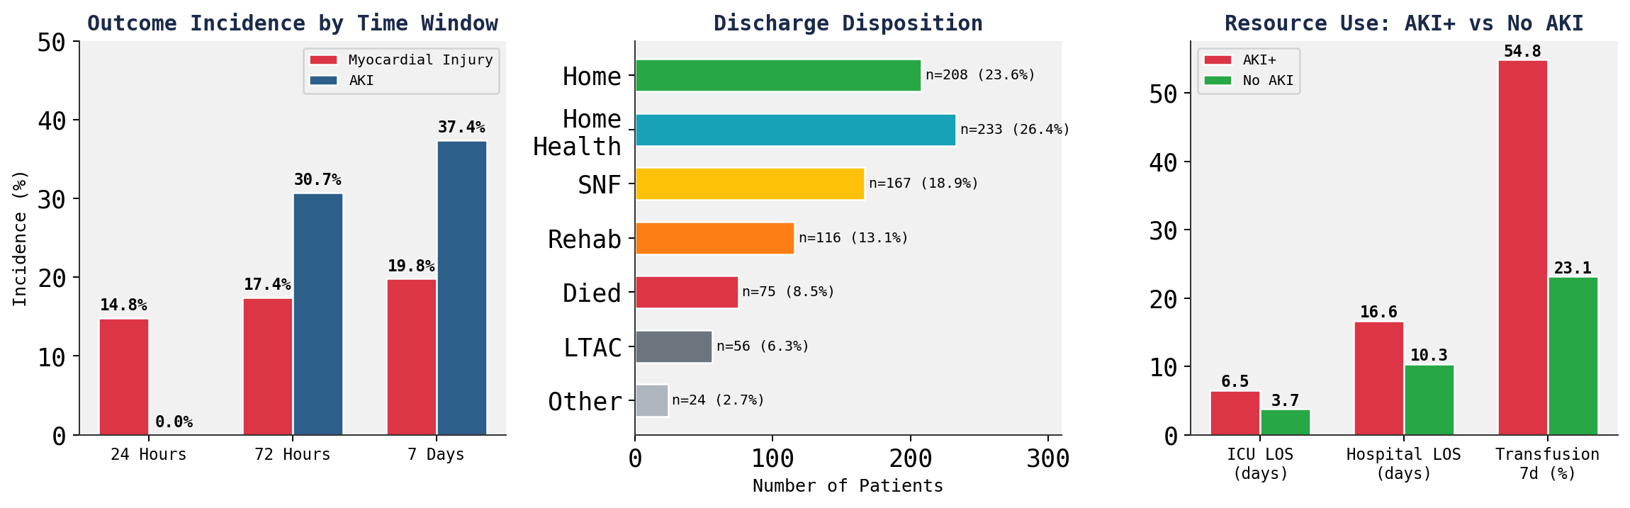
Secondary Outcomes: Cardiac Injury, Mortality & Resource Use
Troponin > 0.04 ng/mL defining myocardial injury
Summary
In-hospital mortality: 8.0% (n=71). Nearly 1 in 5 patients (19.8%) experienced myocardial injury within 7 days. AKI patients had 76% longer ICU stays (6.5 vs 3.7 days) and 2.9x higher mortality (13.6% vs 4.7%). 50.1% of patients discharged to home or home health care; 19.5% required extended care (SNF/LTAC).
7/9

Slide 28
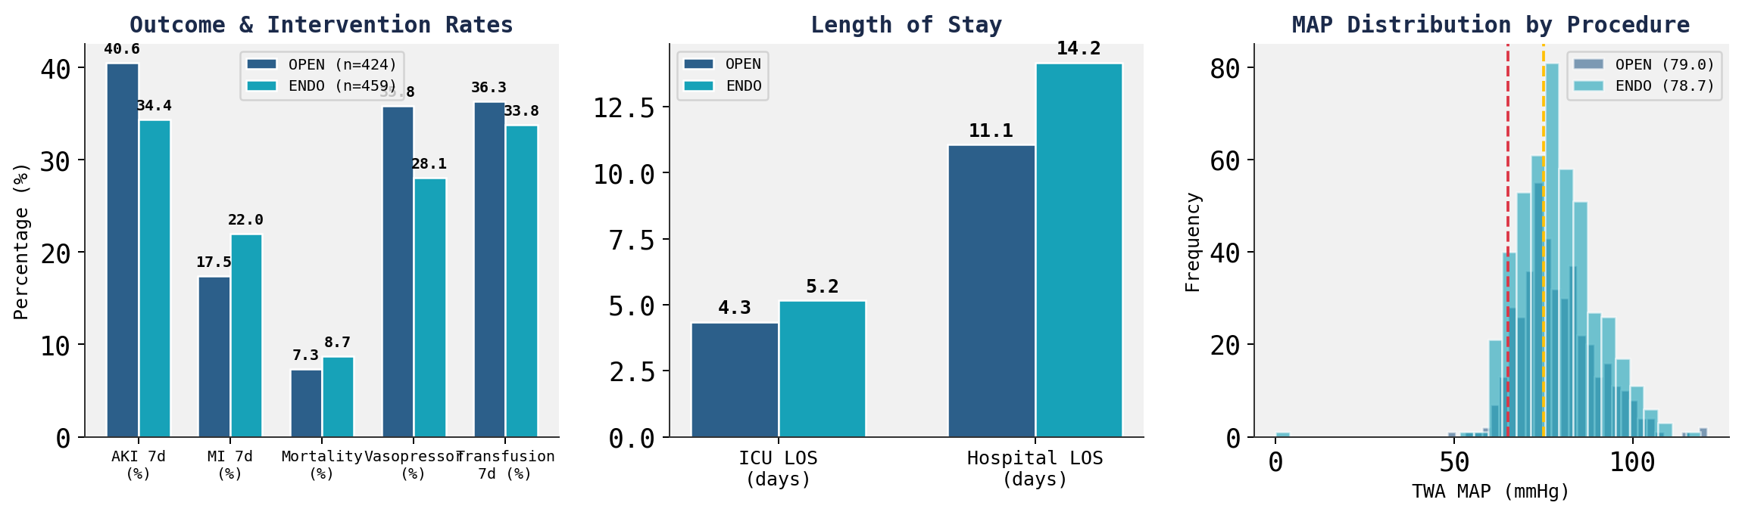
Surgical Approach Comparison: Open vs. Endovascular
Head-to-head comparison of perioperative profiles
Key Differences
Notable
OPEN: Higher AKI rate (40.6% vs 34.4%, p=0.07), more vasopressor use (35.8% vs 28.1%), higher transfusion (39.6% vs 30.7%). Older patients (68.7 vs 64.7 yrs). Despite more complex procedures, shorter hospital LOS.
ENDO patients had higher myocardial injury rates (22.0% vs 17.5%) and longer hospital stays (14.2 vs 11.1 days), potentially reflecting a sicker baseline population requiring emergent endovascular repair (e.g., ruptured AAA).
8/9

Slide 29
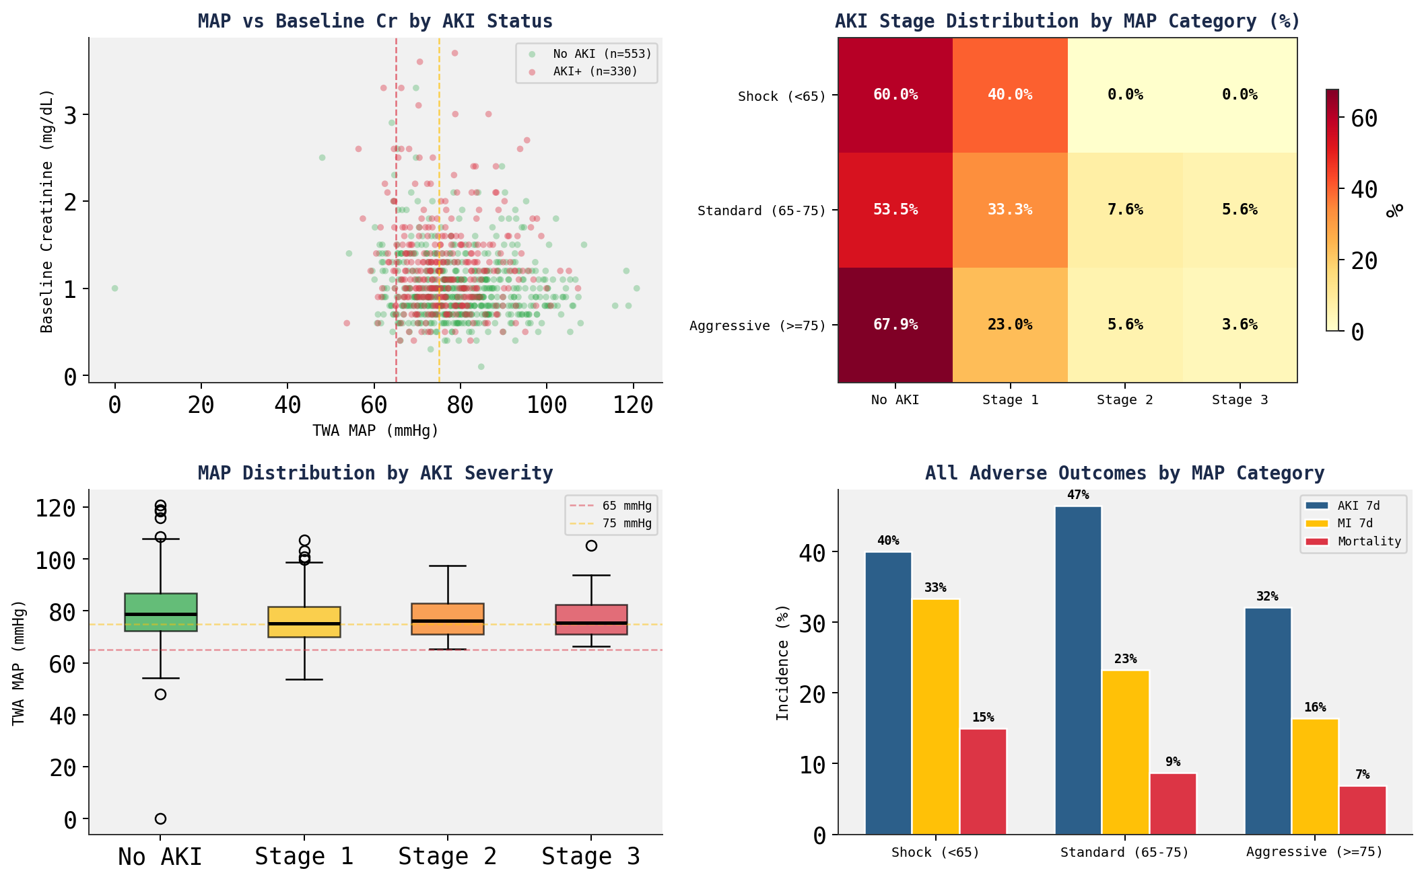
Integrated Risk Landscape: MAP, AKI & Cardiac Events
Multi-dimensional view of hemodynamic exposure and organ injury
9/9

Slide 30
Conclusions & Deliverables
Key Findings
Project Deliverables
1.
37.4% of vascular surgery patients developed AKI within 7 days — a clinically significant burden.
Robust Cohort Script: SQL pipeline isolating true vascular surgery patients (n=883 from MIMIC-IV)
Cleaned Vitals Dataset: High-resolution MAP readings (1-5 min intervals), artifacts removed, gaps interpolated
2.
Lower MAP is associated with higher AKI risk: Standard (65-75 mmHg) group had the highest AKI rate at 46.5%.
Master Analytical Dataset: 883 patients x 115 variables, ready for modeling
3.
Patients with AKI had 2.9x higher mortality (13.6% vs 4.7%, p<0.001) and 76% longer ICU stays.
4.
19.8% experienced myocardial injury (troponin > 0.04), with rates increasing across observation windows.
Future Directions
5.
Baseline CKD (55.3%), CHF (50.3%), and complicated HTN (52.4%) were the strongest comorbidity risk factors for AKI.
Propensity score matching using comorbidity matrix
6.
Hierarchical baseline creatinine strategy achieved 100% cohort coverage; AKI rates were consistent across priority classes (32-40%).
Multivariable logistic regression for AKI prediction
Area Under Threshold (AUT) calculation for MAP < 65 and < 75
Subgroup analysis of complex aortic procedures (n=76)
10/9

